Slide 1
Unit 2- Technology Systems
Please do not start the test until you have been told to do so.
This test is 1 hour long and contains 50 marks over 15 – 20 screens.
The number of marks are in brackets e.g. (2)
Some questions are multiple choice requiring one or more answers from a list of possible answers 1 mark.
Some questions require you to write a short answer 1-2 marks.
Some questions require long answers 8 marks.

Slide 2
Enter the details below
Name:
Candidate number:
Centre name:
Centre number:

Slide 3
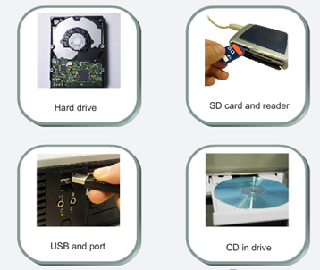
The images show some storage devices
Question 1 of 18
Identify the device which uses optical media. (1)
Click the correct image.

Slide 4






A photographer wants to produce a calendar showing his favourite photographs
Question 2 of 18
Choose the correct one.

Slide 5
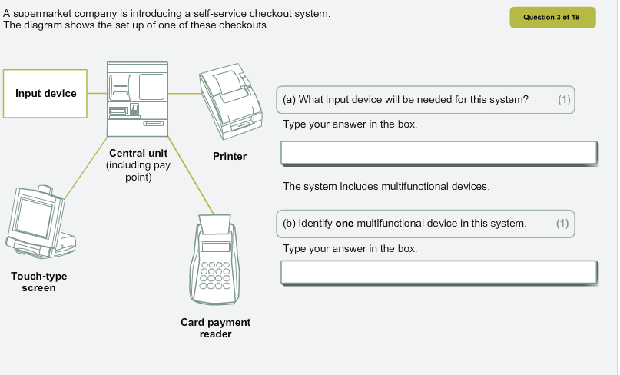

Slide 6
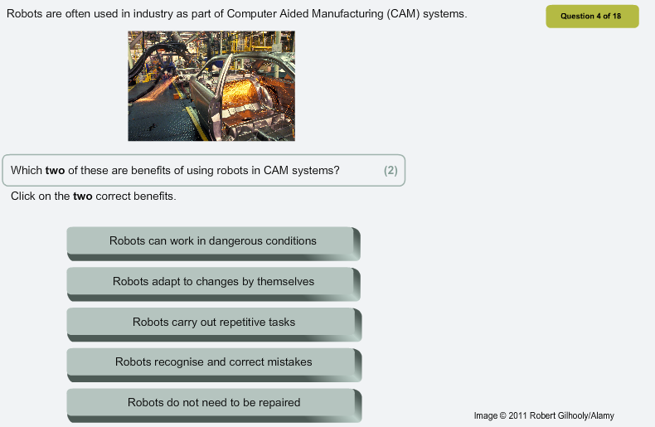

Slide 7
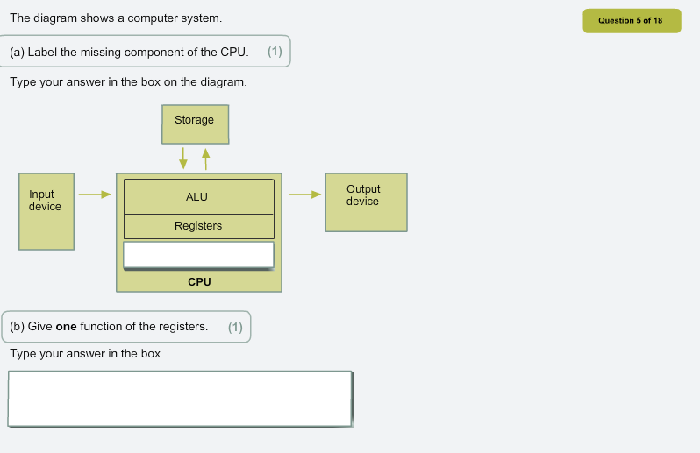

Slide 8
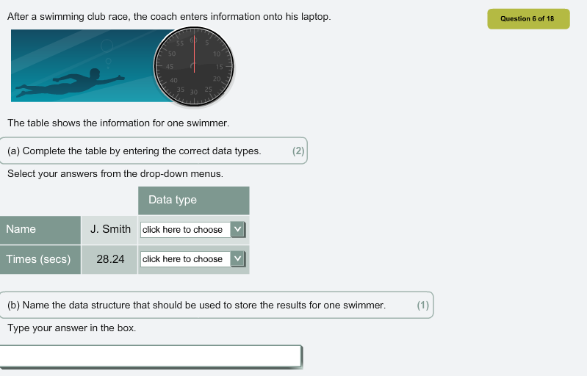

Slide 9
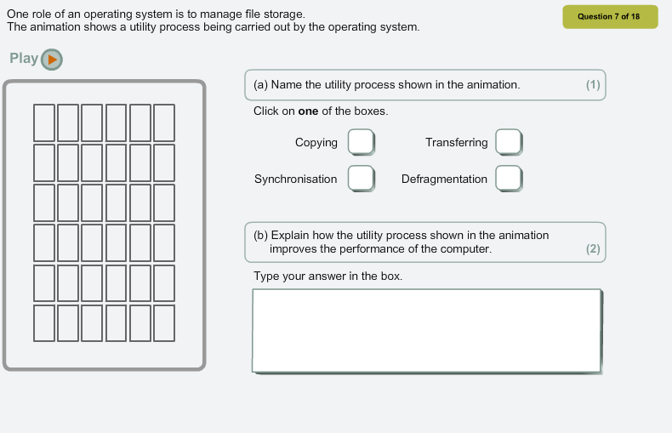


Slide 10
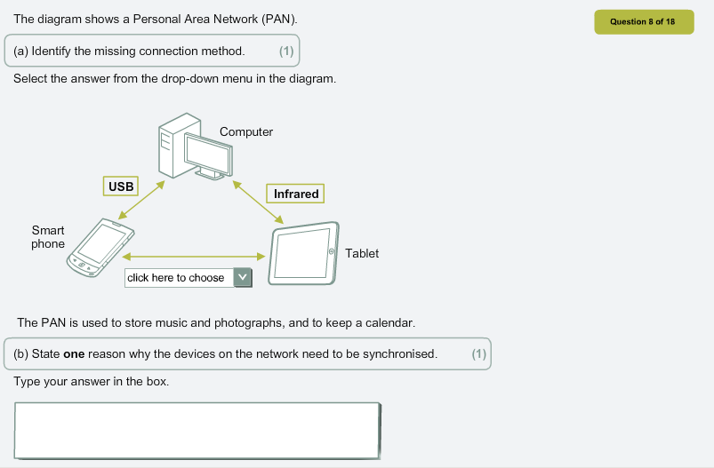

Slide 11
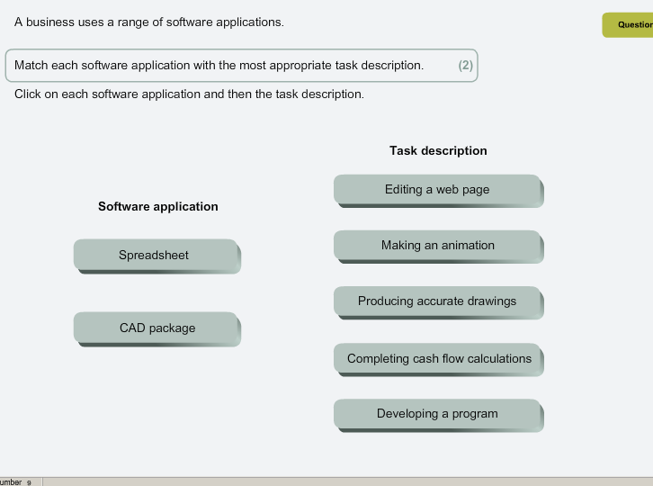
Match the software with the task by typing the right number
1
2

Slide 12
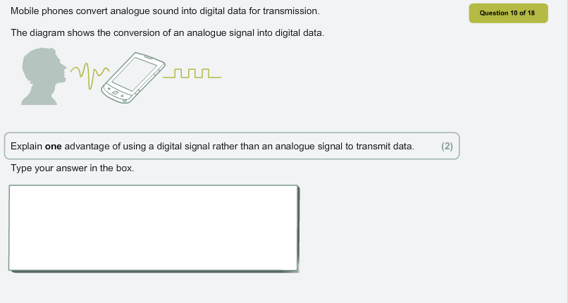

Slide 13
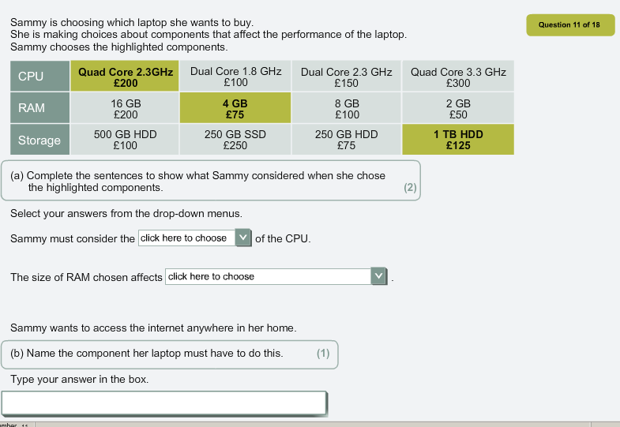

Slide 14
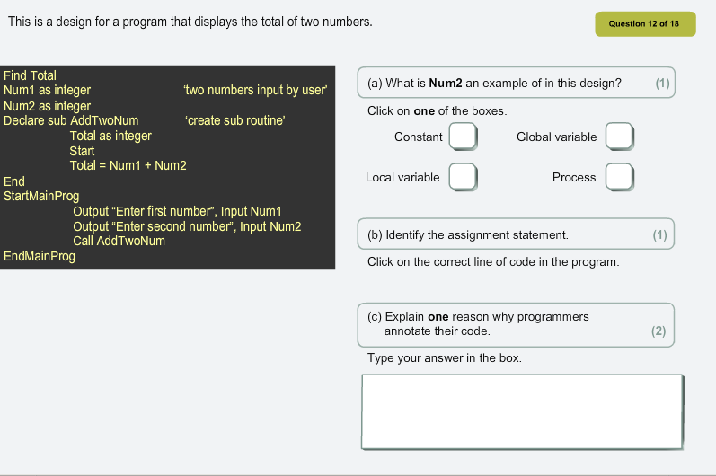

Slide 15
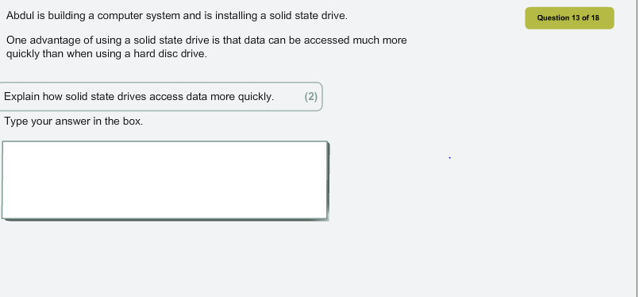

Slide 16
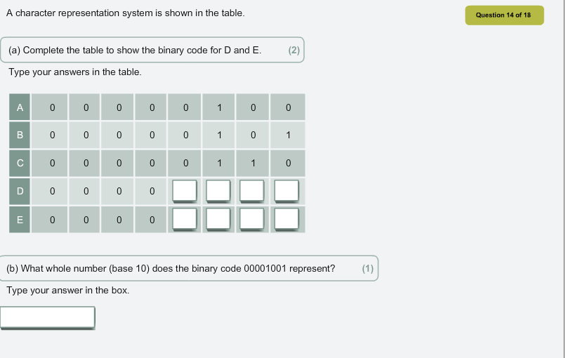

Slide 17
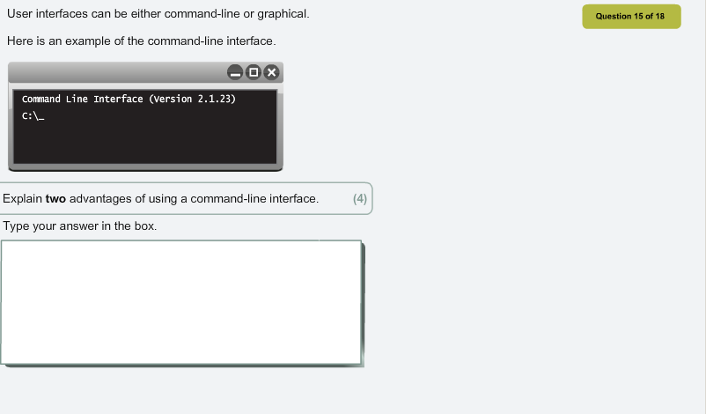

Slide 18
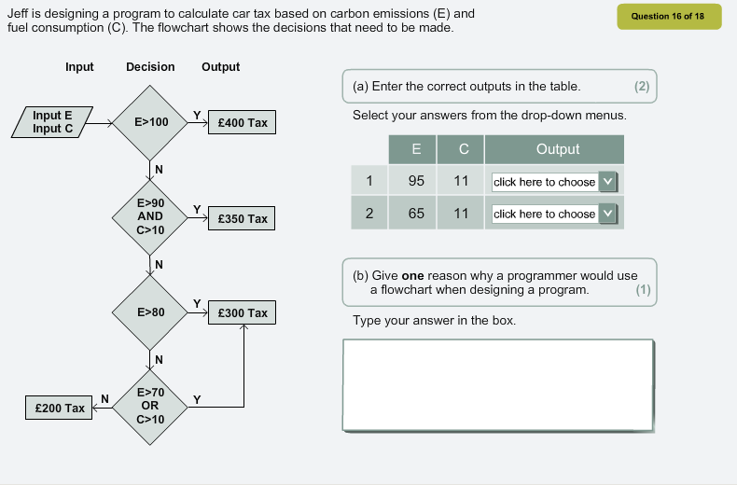

Slide 19
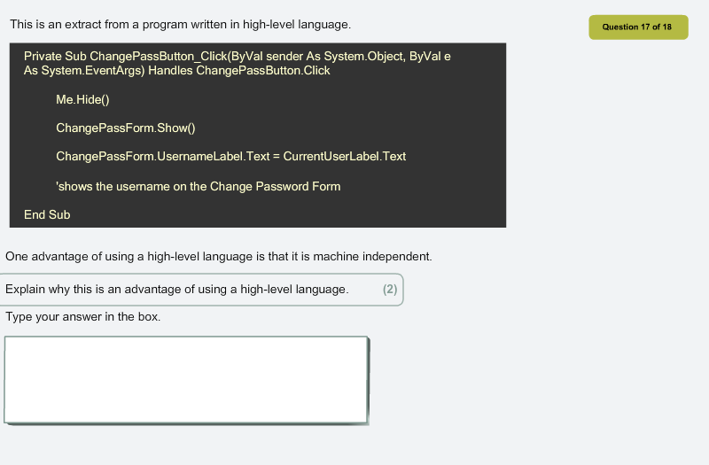

Slide 21
